Slide 1
Text Based Steganography
Network Security and Cryptography Fundamentals
Nithya Sharma (19MIA1028)
Tharani Kumar (19MIA1033)
Parvathy AJ (19MIA1048)

Slide 2
Steganography
Steganography is the process of hiding a secret message within a larger one in such a way that someone can not know the presence or contents of the hidden message.
The purpose of Steganography is to maintain secret communication between two parties. Unlike cryptography, which conceals the contents of a secret message, steganography conceals the very fact that a message is communicated.

Slide 3
Motivation
Theft of leakage of confidential data can prove to be detrimental. So its crucial to ensure the complete security of the data to prevent it from falling into the wrong hands.
Steganography can be used to hide important data inside another file so that only the parties intended to get the message even knows a secret message exists.
It’s a very important part of the future of Internet security and privacy on open systems such as the Internet.

Slide 4
Objectives
To create functions for binary conversion.
To create an encoder and decoder function.
To successfully hide a given text in an image.

Slide 5
Advantage Over Cryptography
The advantage of steganography over cryptography alone is that the intended secret message does not attract attention to itself as an object of scrutiny.
Plainly visible encrypted messages, no matter how unbreakable they are, arouse interest and may in themselves be incriminating in countries in which encryption is illegal.

Slide 6
Technologies Used
Open CV
Least Significant Bit Steganography
Python Imaging Library

Slide 7
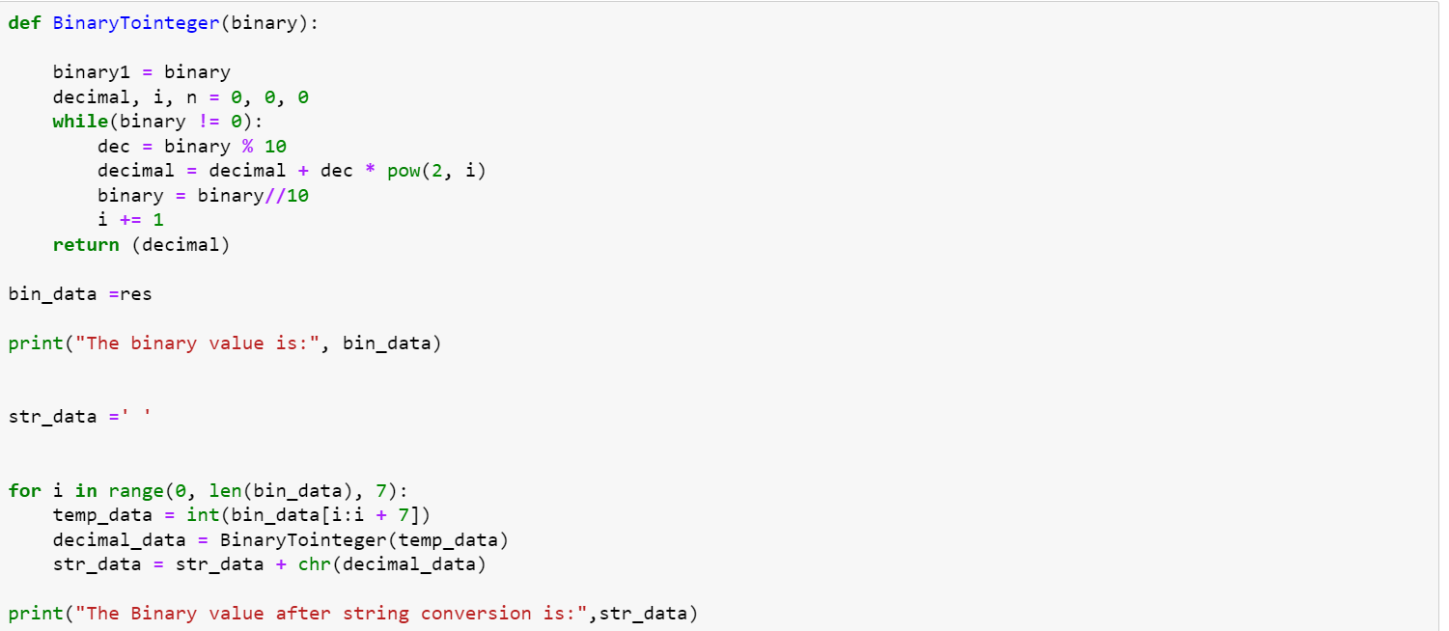
Converting Binary to Integer

Slide 8
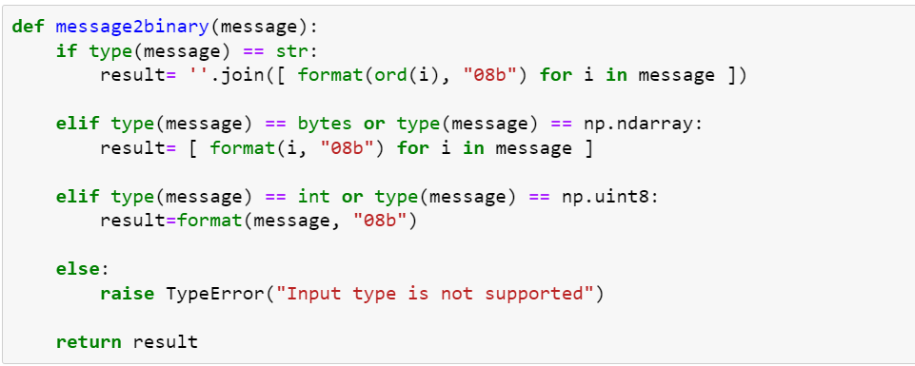
Converting Message to Binary

Slide 9
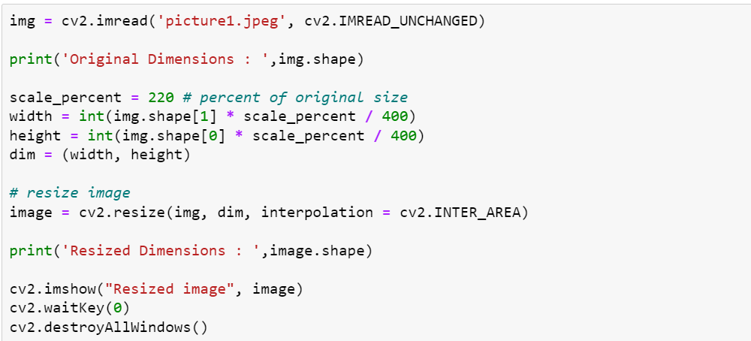
Image Resizing

Slide 10
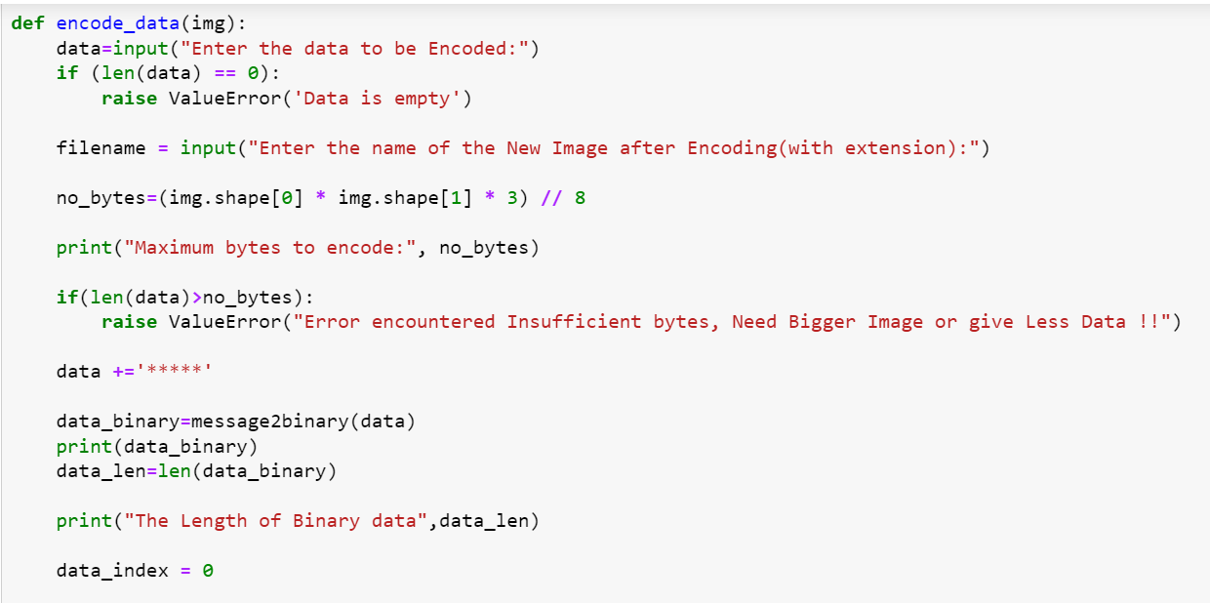
Encoder Function

Slide 11
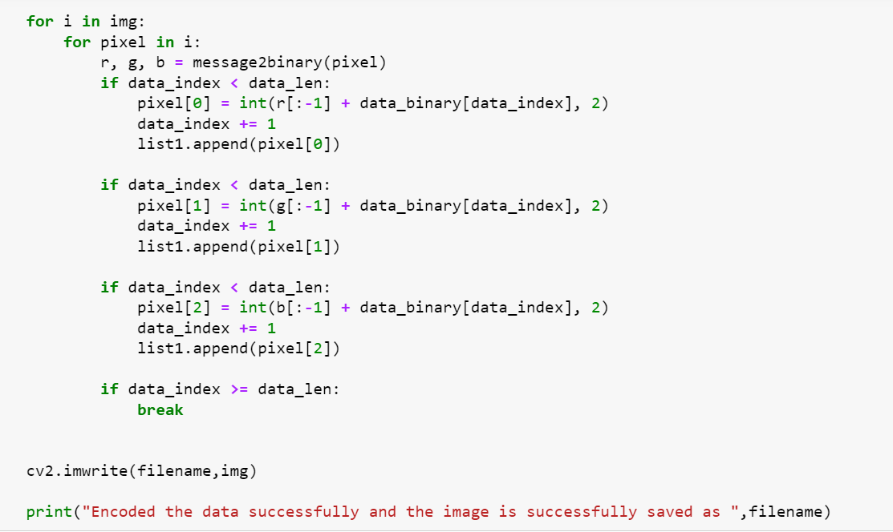
Encoder Function

Slide 12
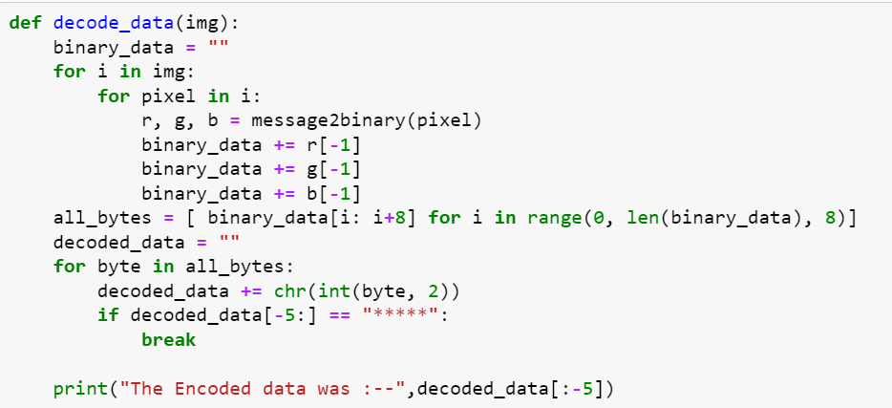
Decoder Function

Slide 13
THANK YOU

